Slide 1




Odder
Squatters

Slide 2

Kaggle Competition

Slide 3
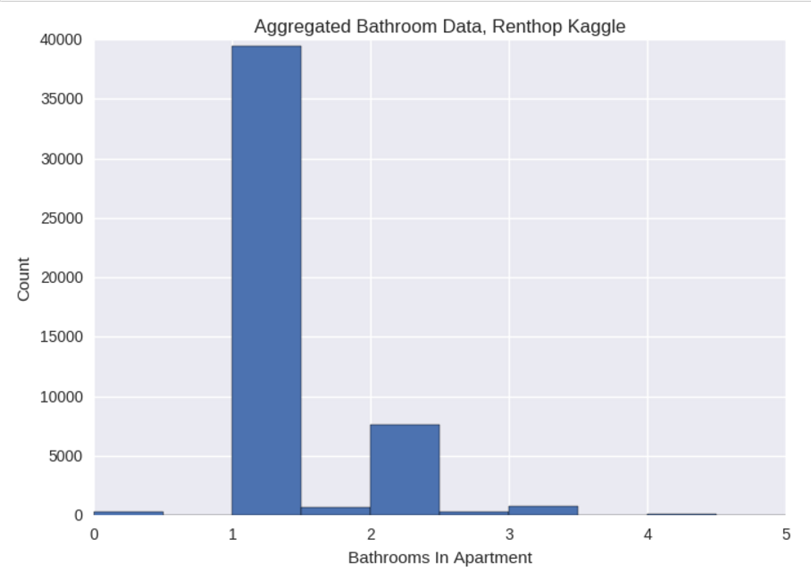
What’s In The Data?

Slide 4

Normal Data is Elusive

Slide 5
Building
Models

Slide 6

Random Forest: Easy To Implement

Slide 7
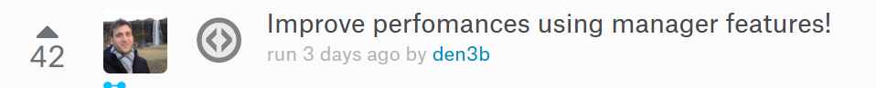

Is Manager Skill Predictive of Interest Level?

Slide 8
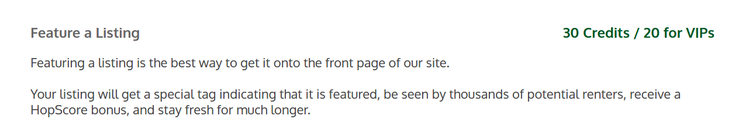
Paying Money to Renthop is Predictive of Interest Level
“Each listing on our site comes with their own unique HopScore ranging from 0 – 100. Listings with higher scores are better and appear at the top of search results where they’ll receive more exposure from renters.”

Slide 9
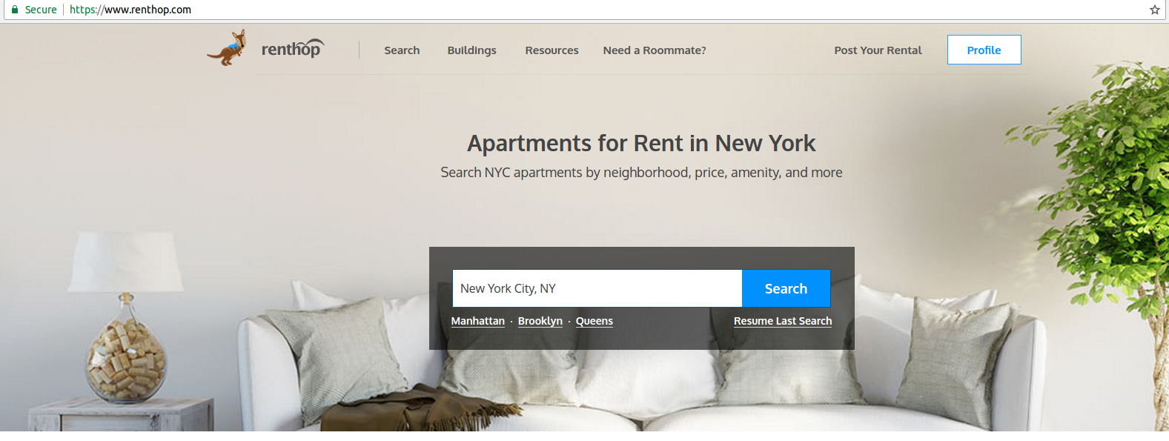
Investigate The Source

Slide 10
Logistic Regression : Peng

Slide 11
XGBoost: Amit

Slide 12
Putting It
Together

Slide 13

Ensembling Theory is Scattered, so K.I.S.S.

Slide 14
Results Turned Out Well!
logloss = .55058

Slide 15
Thank
You
Odder
Squatters
Odder
Squatters
Odder Squatters

